Slide 1
American War and War Heroes
Performed: Kutin Zakhar

Slide 2
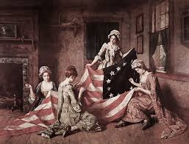
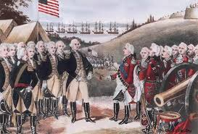
US War of Independence
US War of Independence - military operations in North America from 1775 to 1783.

Slide 3
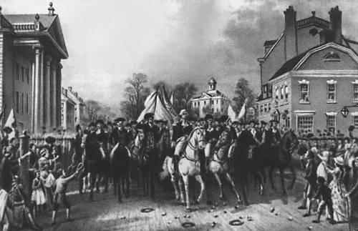
Reasons for the war
Sorts of restrictions of the North American colonists:
economic
legal
territorial
and others

Slide 4
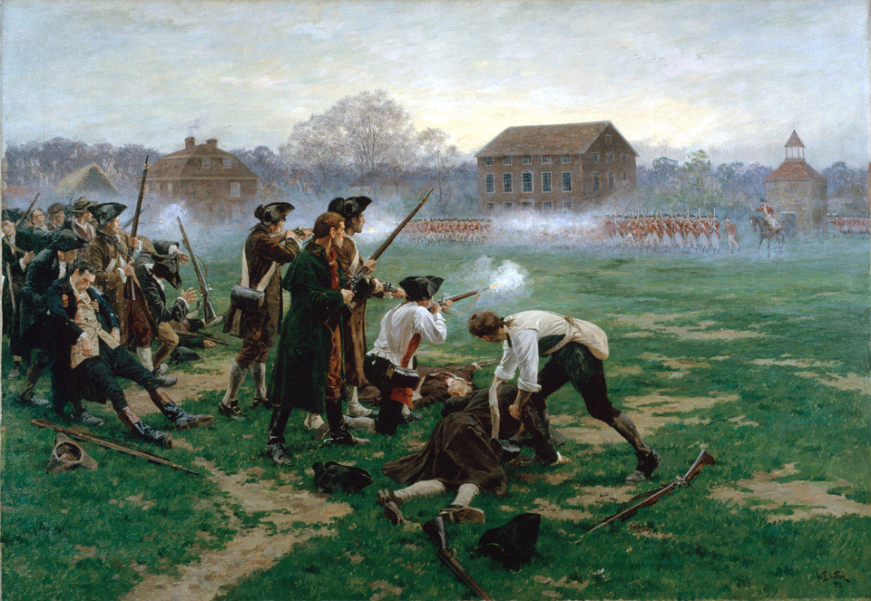
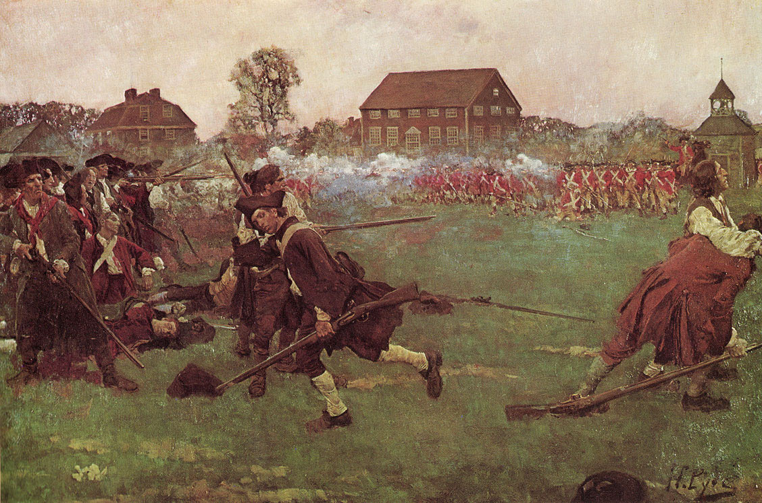
The first military clash
On April 19, 1775 — In Lexington, in the town square, the royal battalions met with detachments of volunteer colonists.

Slide 5
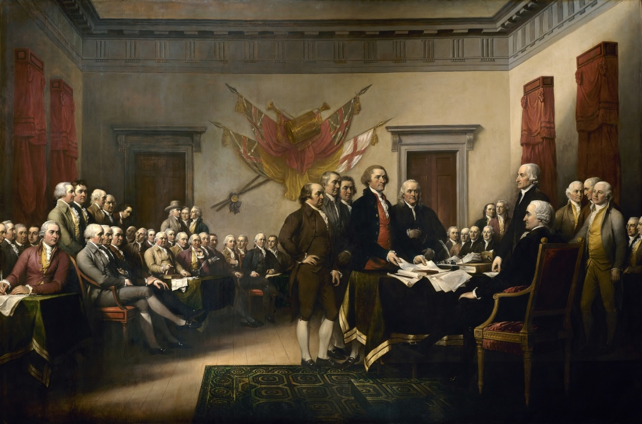
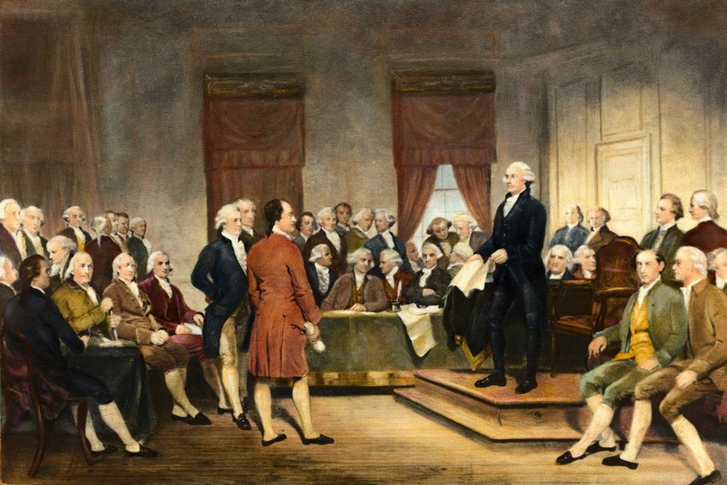
The second continental Congress
The second continental Congress was opened on may 10, 1775. George Washington was appointed commander-in-chief of the entire continental army.

Slide 6
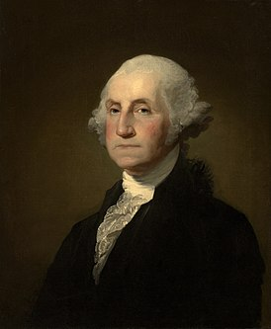
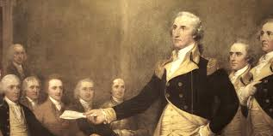
George Washington
George Washington — American statesman, first President of the United States, founding Father of the United States, participant in the war of independence, founder of the American Institute of the presidency.

Slide 7
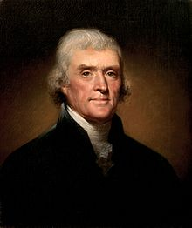
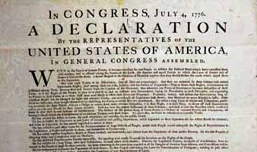
The Declaration of independence
On July 4, 1776, the Second continental Congress adopted the Declaration of independence, written on behalf of Washington by the American educator Thomas Jefferson.

Slide 8
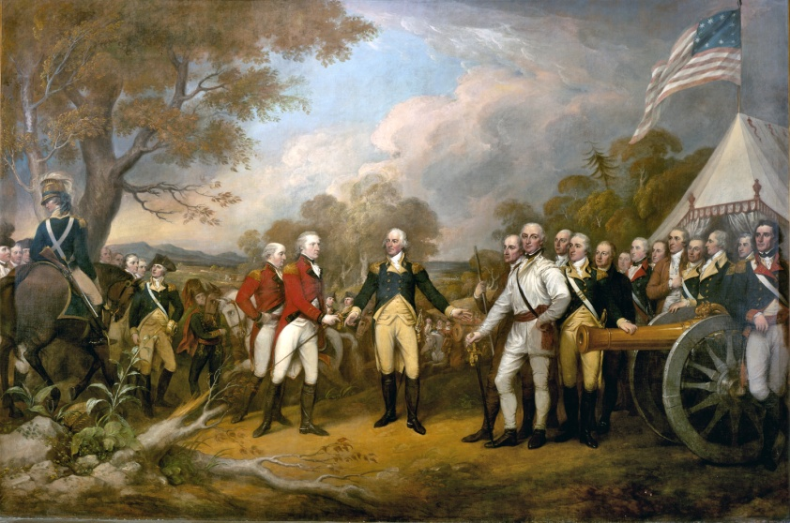
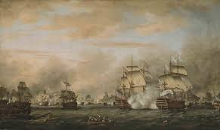
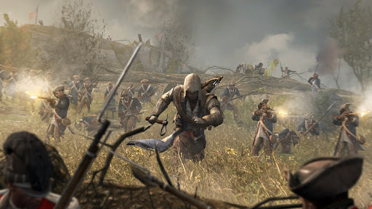
Key and crucial battles
Key and crucial battles in this war were:
the battle of Saratoga
the siege of New York
the battle of All Saints Islands.

